Slide 1
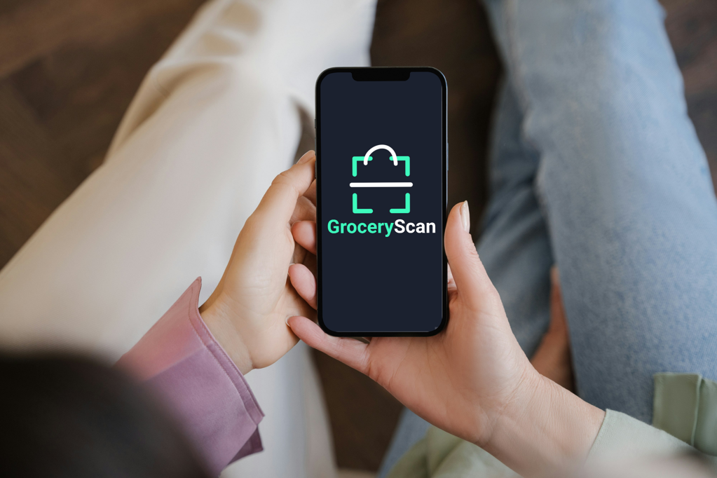
K. Sólyomvári, B. Beregi, Á. Dienes
BDL – Teamwork presentation
Notes:
Hello everyone, first of all, our team would like to introduce you our friend, Sofia…

Slide 2





The problem
Sofia has a food allergy
Difficult to decide
Time consuming to read
No instant alternatives
Notes:
Sofia is allergy to nuts and lactose
She spend a lot of time in supermarkets by reading intgredient on differenct product
Whether she can eat it safely or not
Time consuming, 2 hours/week

Slide 3

The problem is worldwide
The average American spends 120 mins per week at a supermarket
Lactose-free market size is expected for $30 billion by 2029
220M suffer from some food allergy worldwide
Source: nasdaq.com
Notes:
The problem is not just for Sofia only, a research says that an avg. US citizen – 120 mins
Lactose-free market size is expending rapidly
The tendenies are growing, the graph…

Slide 4
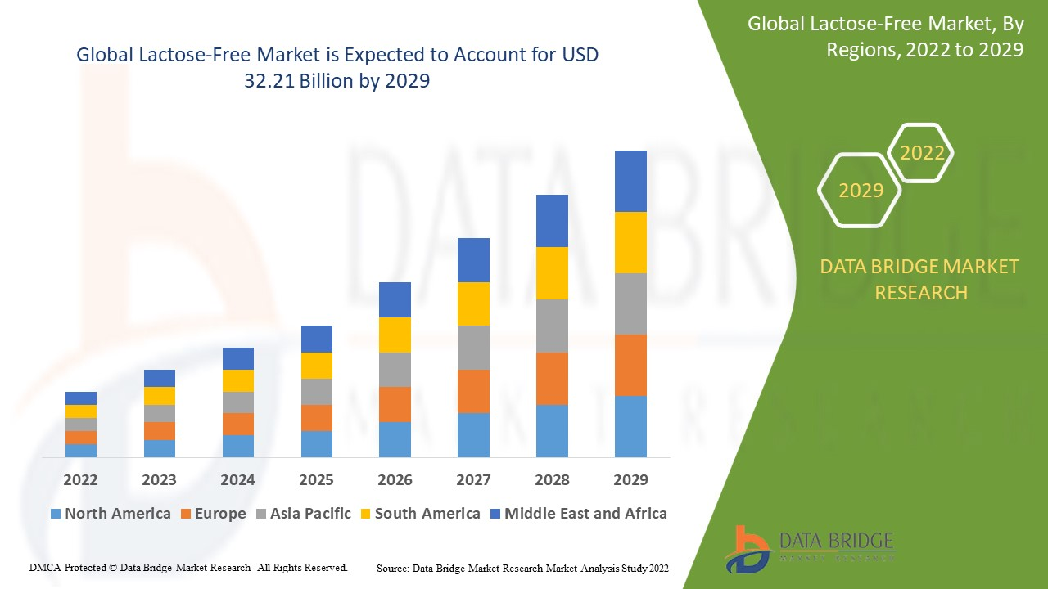
Source: databridgemarketresearch.com
Notes:
Databridgemarketresearch, In fact, I was at a lab for lactose and lactoluse test and it turned out to be +
I was on a lab test this morning and it turned out to be a lactose intollerant

Slide 5
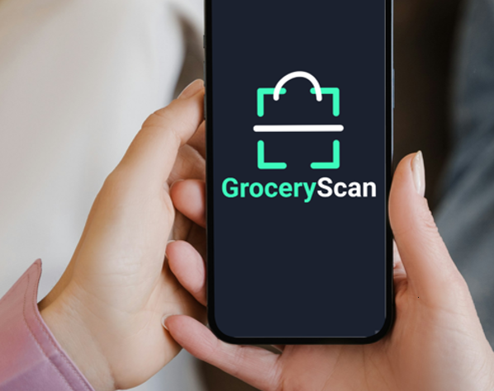
The solution
iOS/Android app
Download
Register
Scan
Be happy!
Notes:
Come up with a solution
Simply download, register, fill, add health document
Scan, make life easier

Slide 6

USP
Provide
Provide valid answer based on the ingredients
Make
Make life with allergies easier
Spare
Spare time & money on shopping
Notes:
3 cornerstones: details
Kata will present about Business Modell Canvas

Slide 7
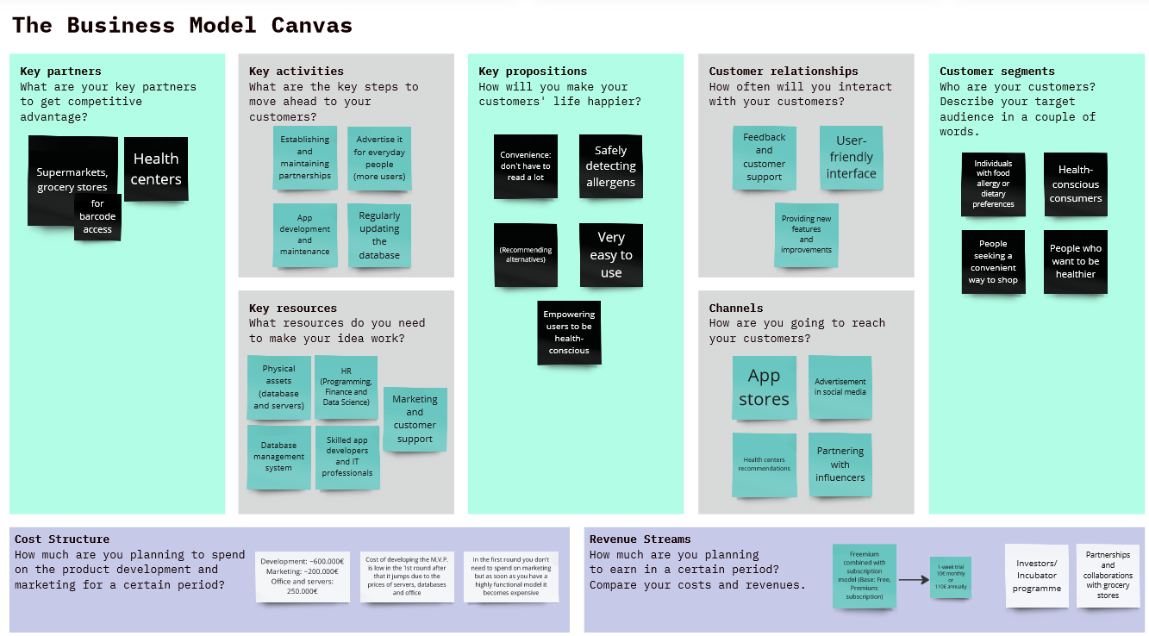
Business Model Canvas

Slide 8
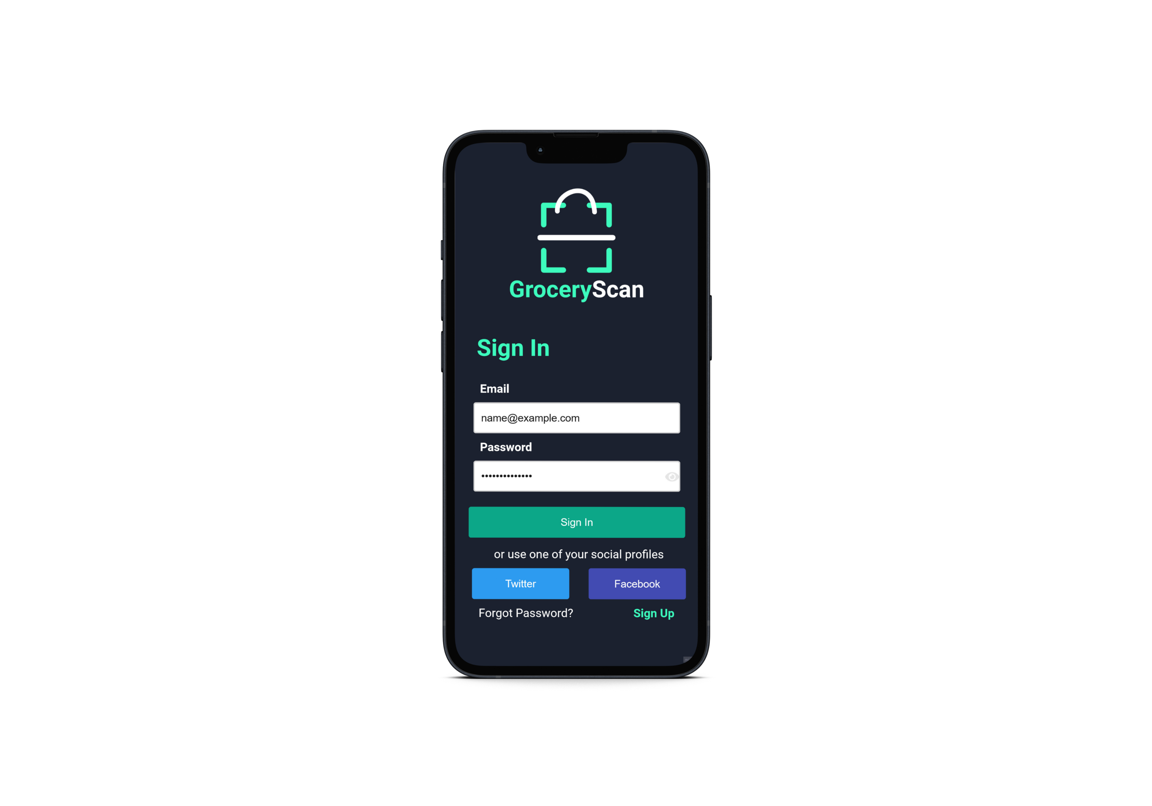
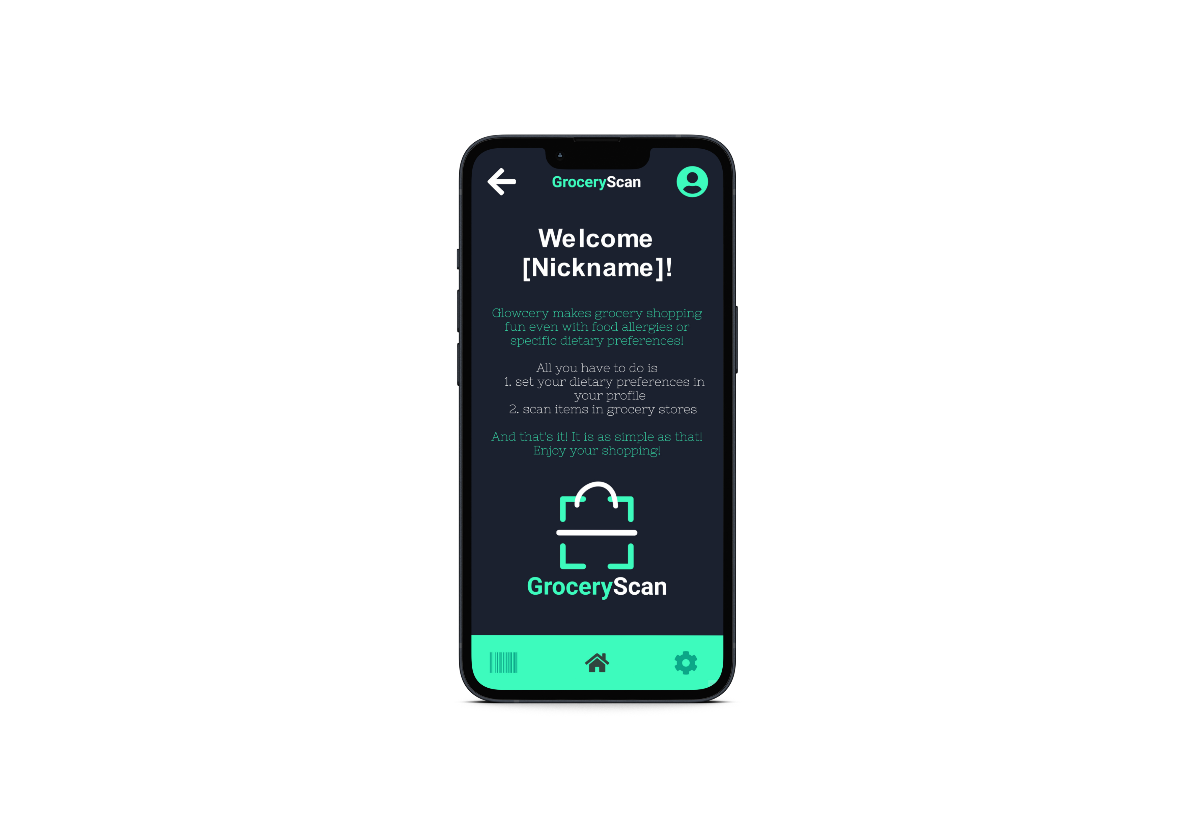
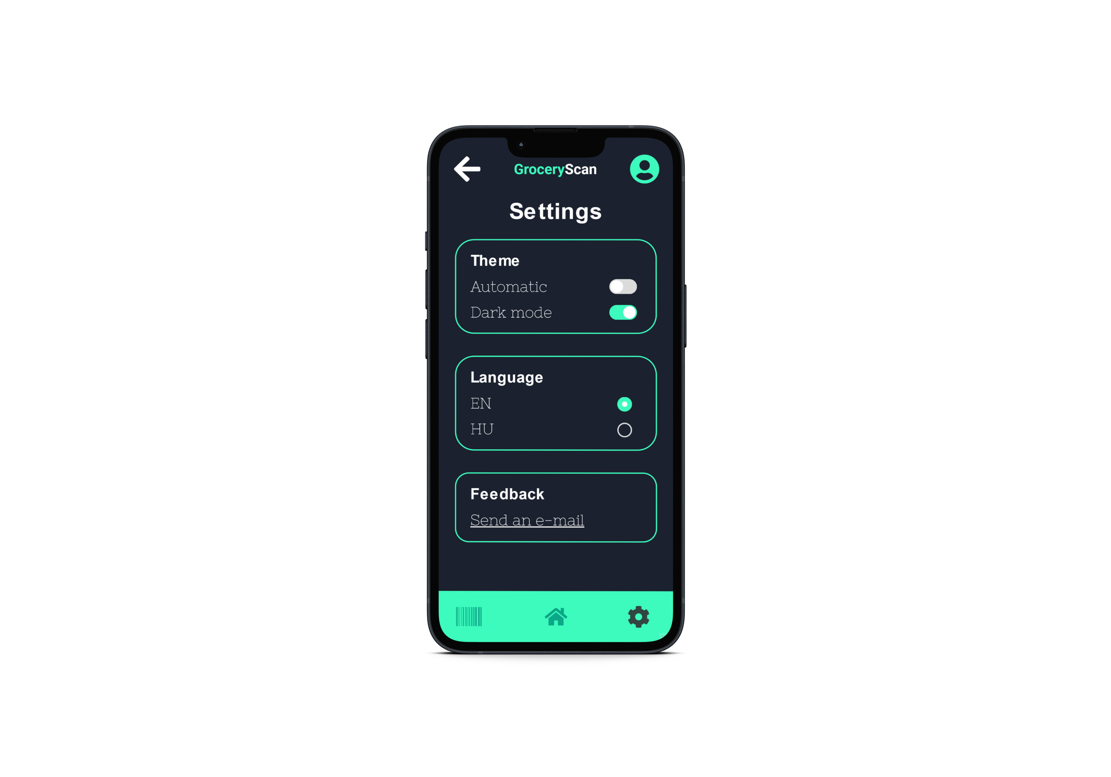
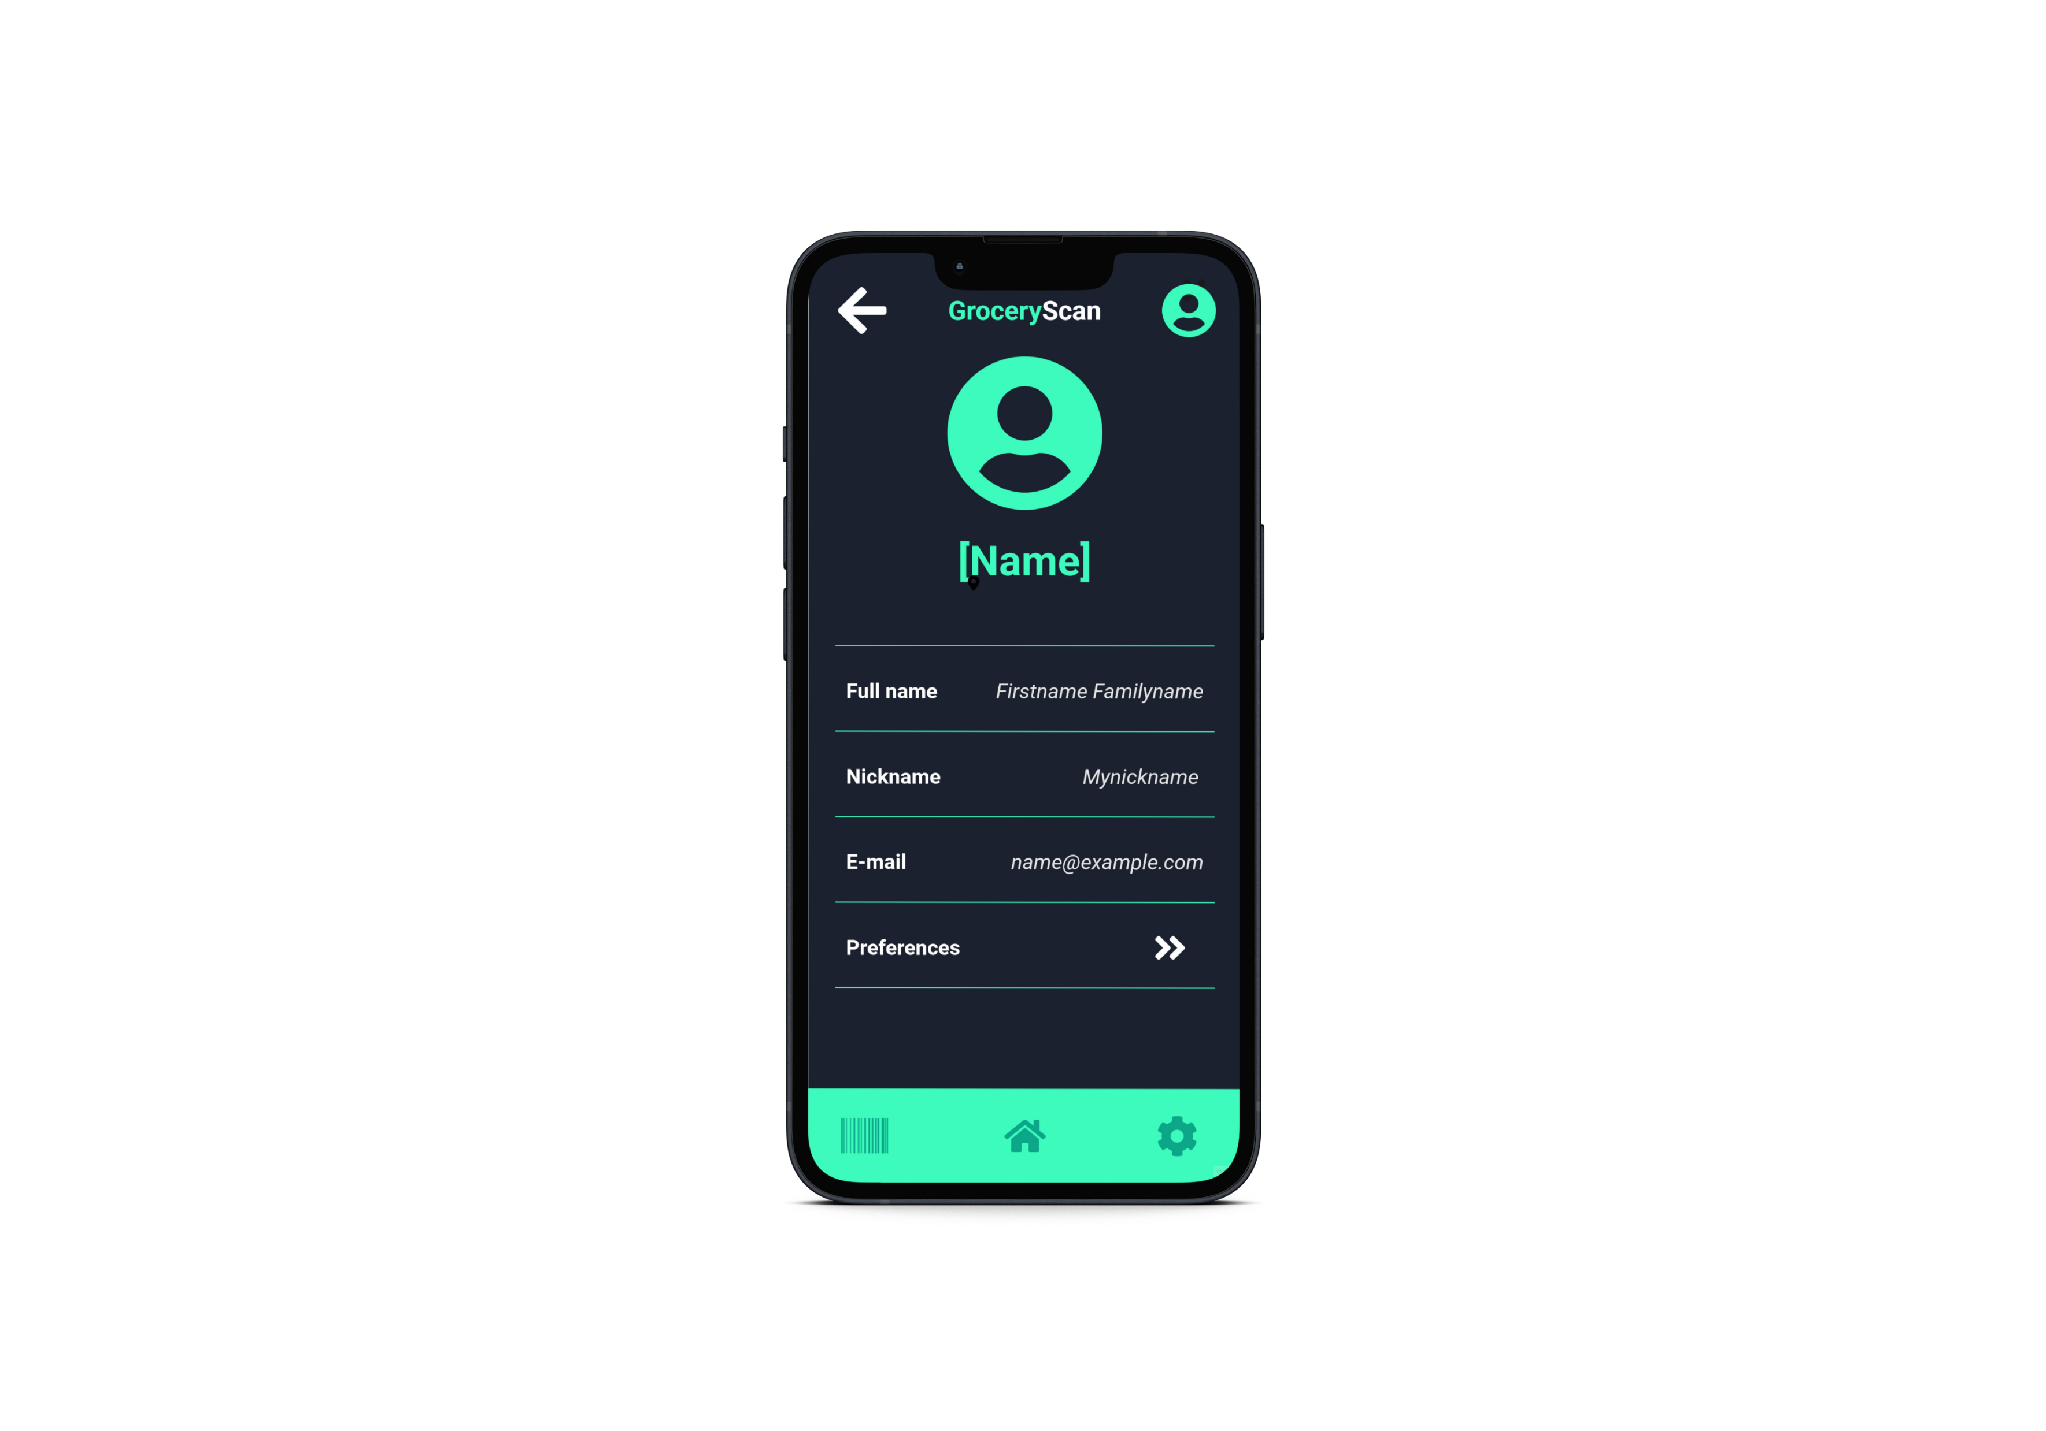
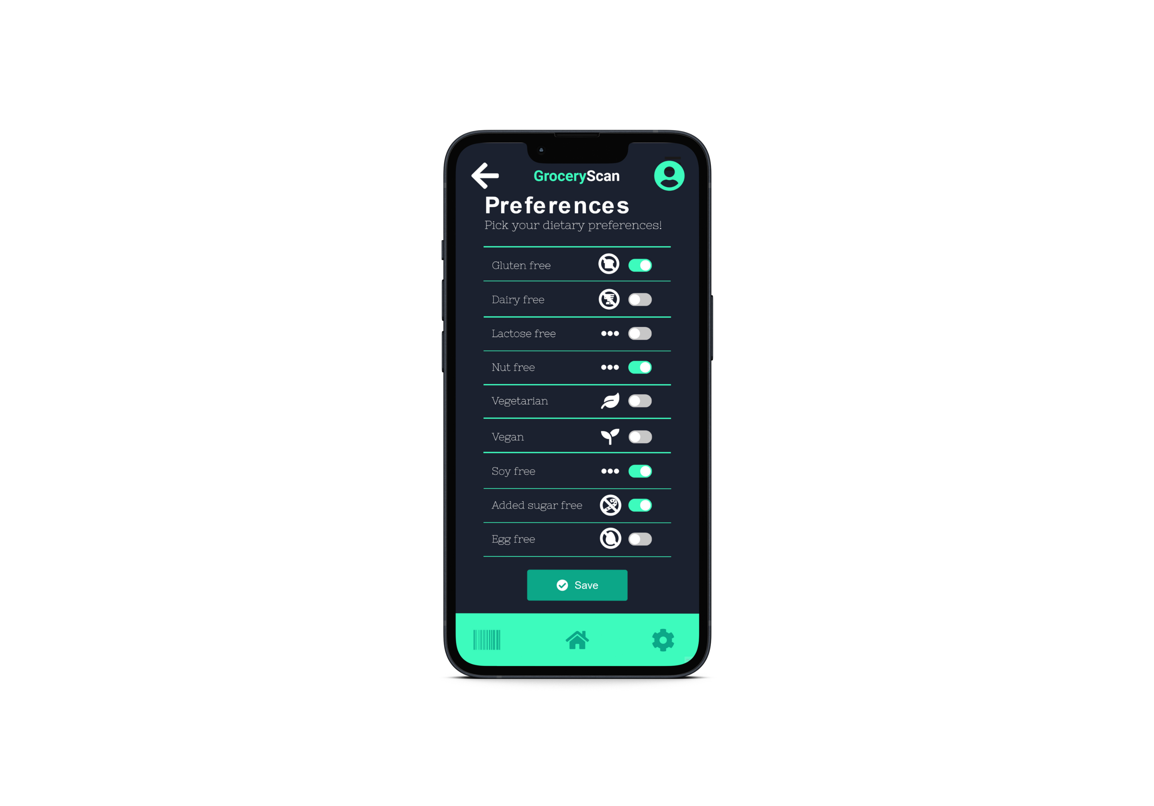
Mockup

Slide 9
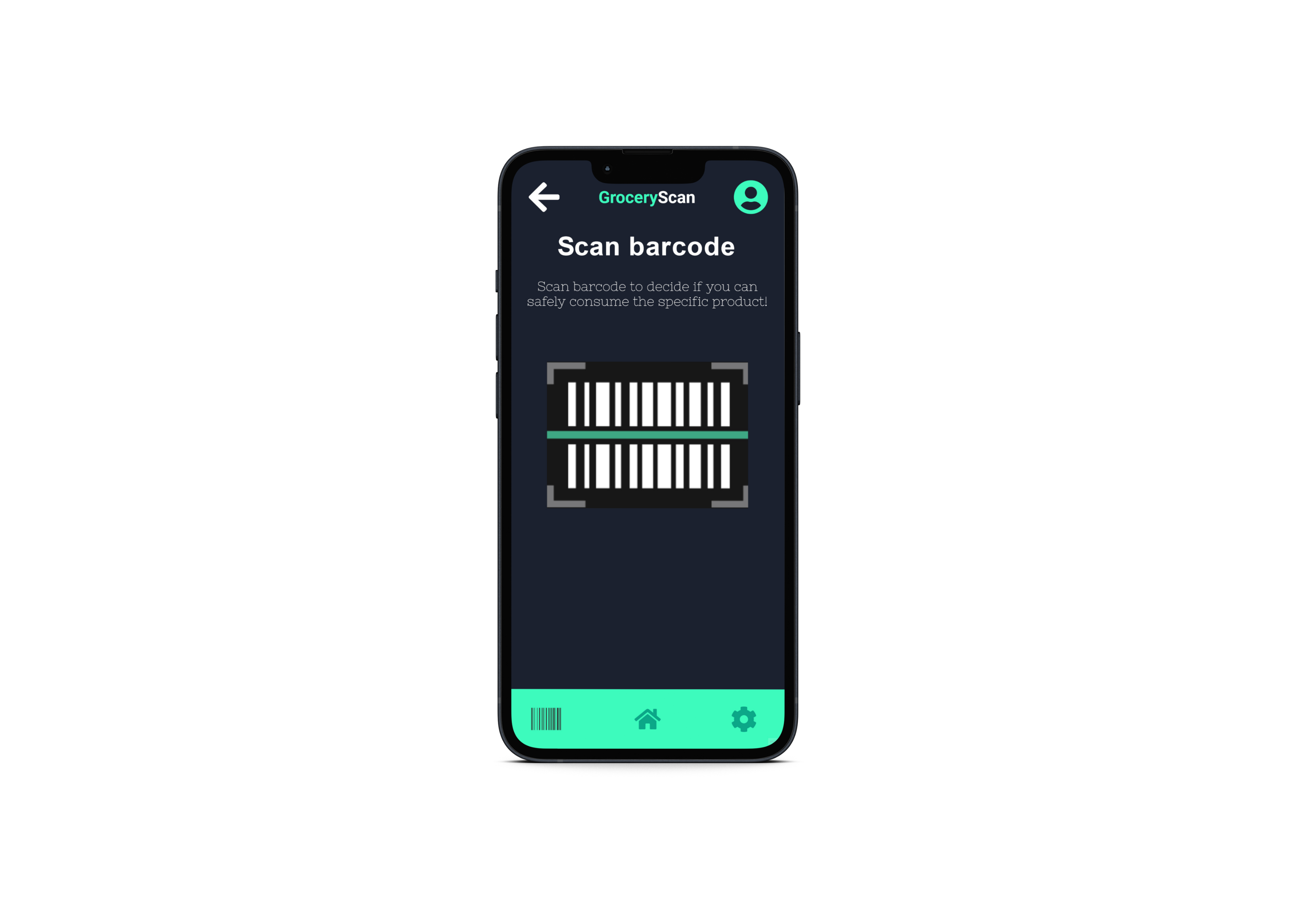
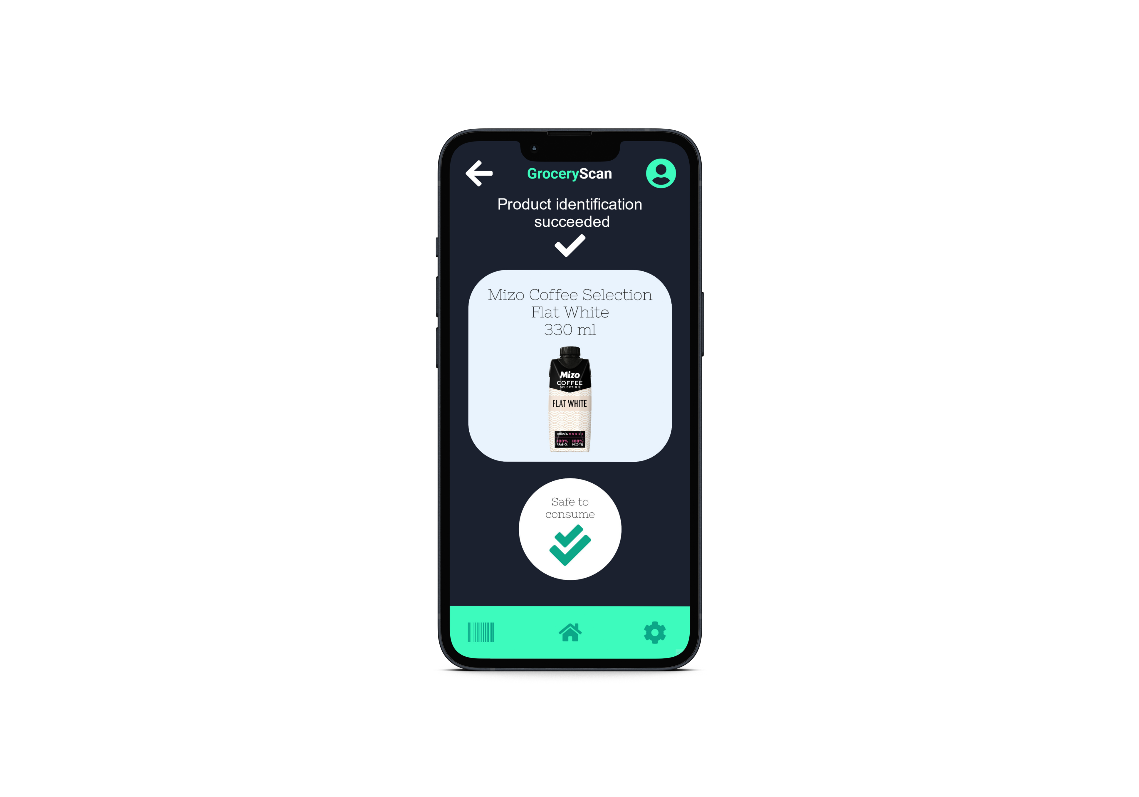
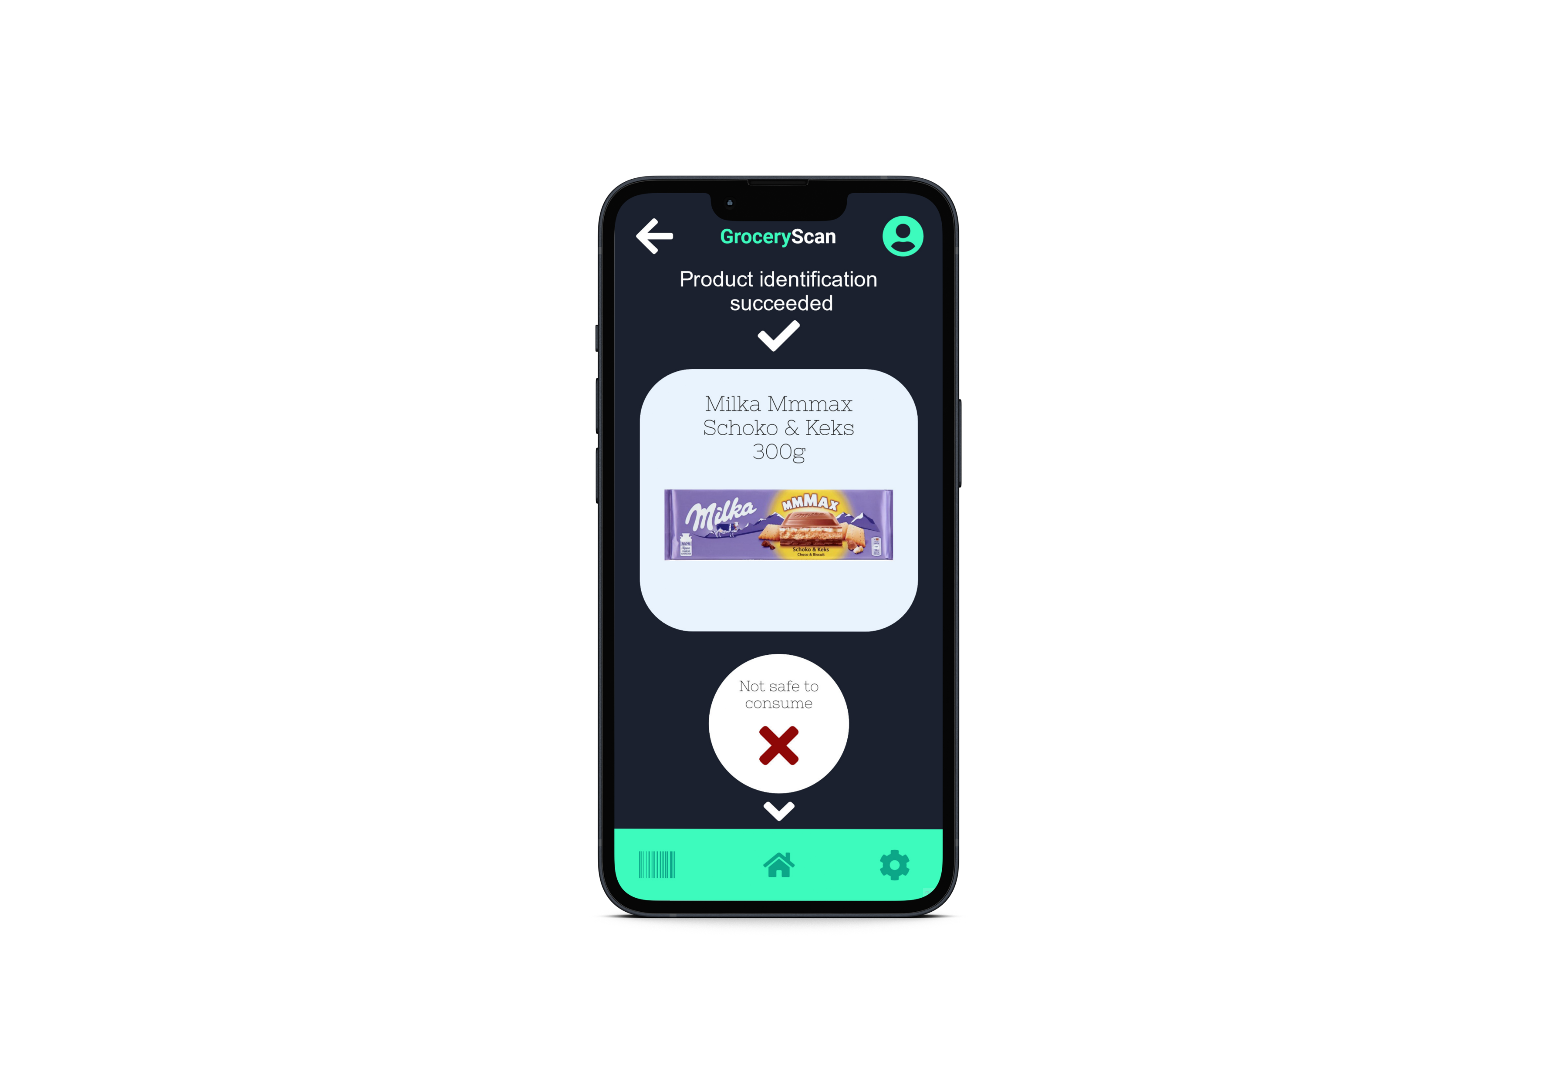
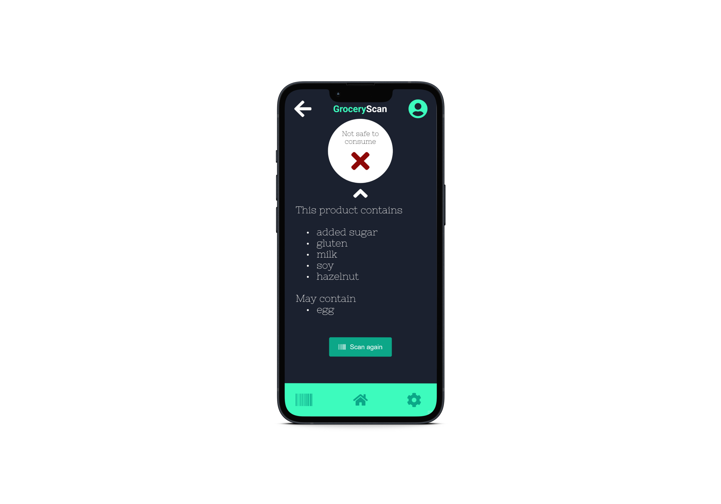
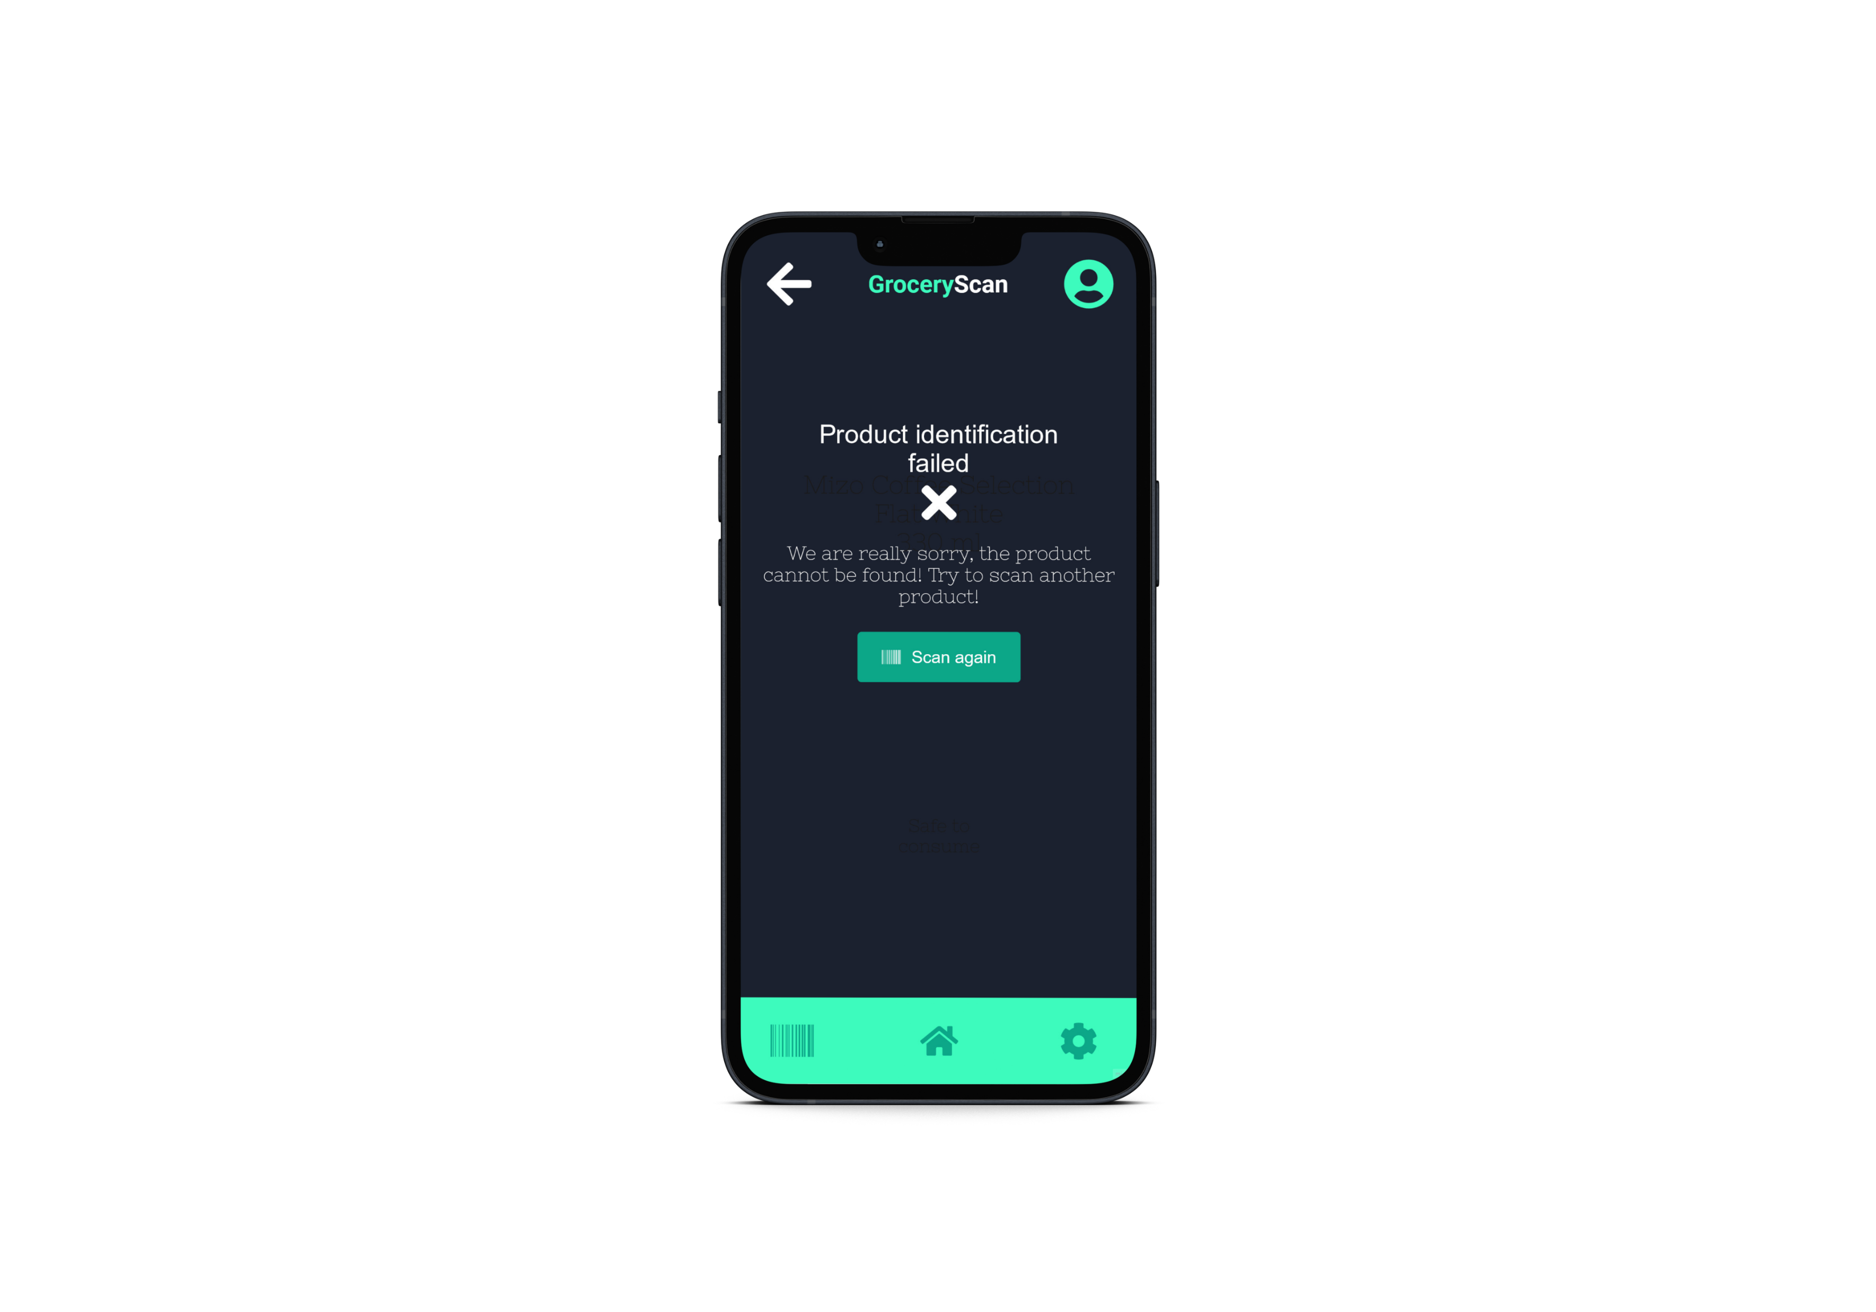

Slide 10


MoSCoW
Must have
Barcode Scanner
Up-to-date database of ingredients
Should have
Alternative suggestions
Warning about possible contents
Could have
Price checker
Recommendation for best value for price store
Won’t have
Ordering through app
Integrate a dynamic price-checking feature that compares product prices across different stores in real-time.
Utilize data analytics to provide users with insights into price trends and fluctuations.
Develop an algorithm that considers both product prices and user preferences to recommend stores offering the best value for money.
Implement a user-friendly interface for easy access to these recommendations.
Implement cutting-edge barcode scanning technology for seamless and efficient product identification
Ensure real-time integration with the app to provide instant and accurate results
Develop a robust and continuously updated database, sourcing information from reliable and reputable databases
Implement a mechanism for real-time syncing to stay abreast of the latest product formulations
Integrate an intelligent recommendation system that suggests alternative products based on user preferences and dietary restrictions.
Utilize machine learning algorithms to enhance accuracy in suggesting viable substitutes.
The app is focused on information and guidance rather than serving as a transactional platform.
Implement a comprehensive warning system that alerts users to potential allergens or ingredients that may not mentioned in the ingredients list.
Utilize AI algorithms to analyze ingredient lists and provide context-aware warnings for enhanced user safety.
Notes:
Must have: Barcode scanner -> seamless and efficient product identification, instant and accurate results
Up-to-date database -> Updated and reliable databases, real-time syncing
Should have:
Alternative suggestions -> Suggest alternative products
Warning about possible content: With AI checking the place of origin and check what else they produce
Could have:
Price checker: Dynamic real-time store compare and analytics of fluctuations
Best value for price store: Find the golden-ratio between value for money and user preferences
Won’t have:
Ordering trough app: This is an informational app rather than a transactional platform

Slide 11
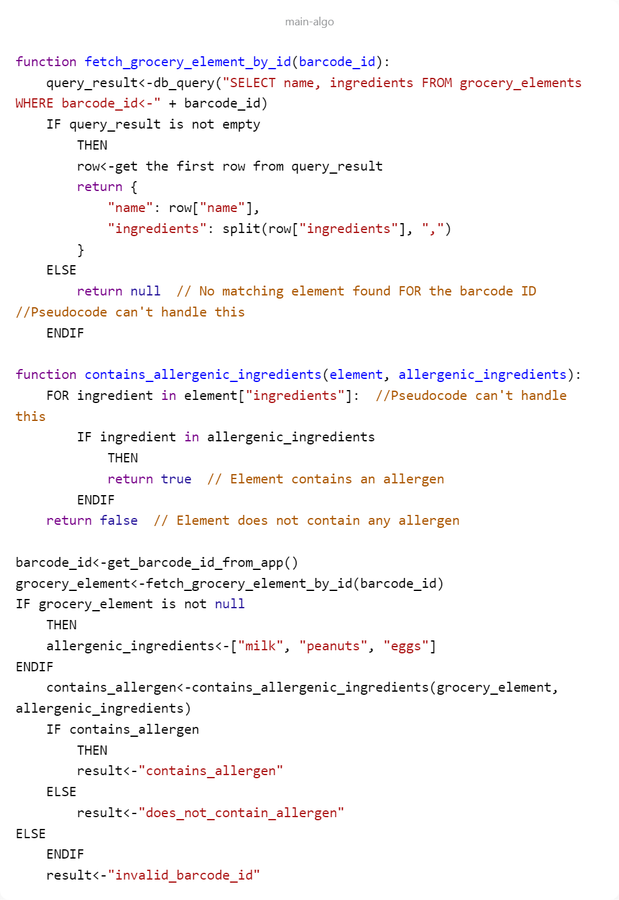
Pseudocode
Mapping of allergenic ingredient from database
Fetch the ingredients from DB for a given barcode
Check whether it contains allergenic ingredient or not
Notes:
function fetch_grocery_element_by_id(barcode_id):
- Search for the specific barcode_id in the database if exists
function contains_allergenic_ingredients(element, allergenic_ingrideints):
- Simple check if any of the allergenic_ingredients are in the ingredients of product
Main:
- gets the barcode
- gets the ingredients from the database based on barcode
- the allergenic_ingredients are set by user
- check whether the product contains allergens
- give back the result to the user (Safe, Unsafe, Barcode not found)

Slide 12

Thank you for Your attention!
Are there any questions?

Slide 13
Backup slide
https://endallergiestogether.com/research/food-allergy-statistics/
https://www.nasdaq.com/articles/the-average-american-spends-this-much-driving-to-the-grocery-store
https://www.databridgemarketresearch.com/reports/global-lactose-free-market

